Slide 2
¿Quienes Somos?

Slide 3
Soluciones

Slide 4
Pruebas de Certificación

Slide 6
Versiv™

Slide 7
Equipo Modular

Slide 8
VERSIV y VERSIV2

Slide 9
Fluke Networks has implemented the SYSTIMAX Link Loss Calculator on the CertiFiber Pro!

Slide 10
There will be a SYSTIMAX LLC Test Limit with IP360 & ULL apparatus for TeraSPEED and LazrSPEED fibers (incl. OM5)

Slide 11
There are three different limits. Based on the limit you select, you can choose the components

Slide 12
LinkWare PC has also been updated to give you more detail of how the loss budget was calculated: OLD

Slide 13
LinkWare PC has also been updated to give you more detail of how the loss budget was calculated: NEW

Slide 14
LinkWare PC

Slide 17
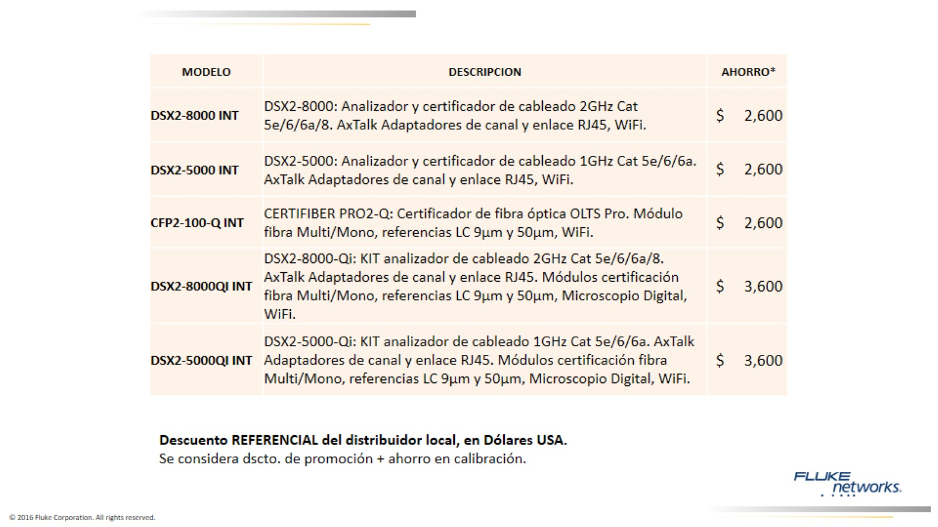

Slide 18
www.networks.pe

Slide 19
https://www.facebook.com/Networks.Peru

Slide 21
Gracias por su tiempo

